Slide 1
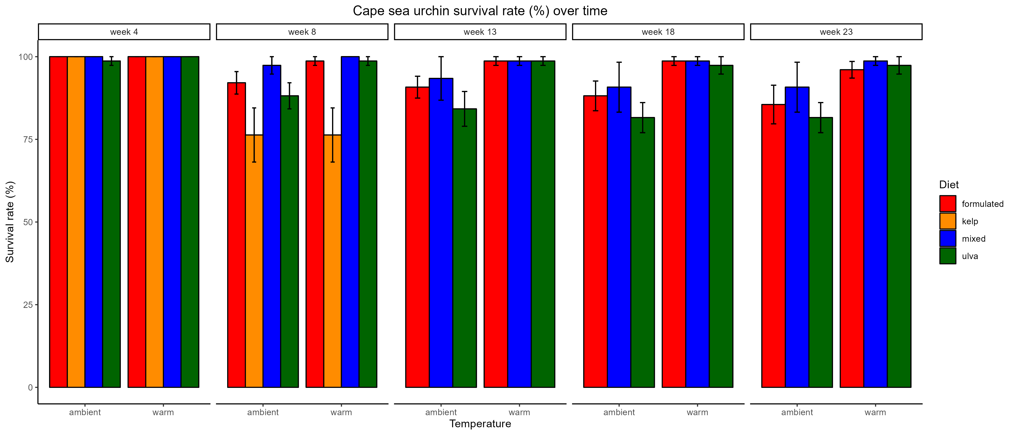
a
a
a
a
ab
ab
b
b

Slide 2
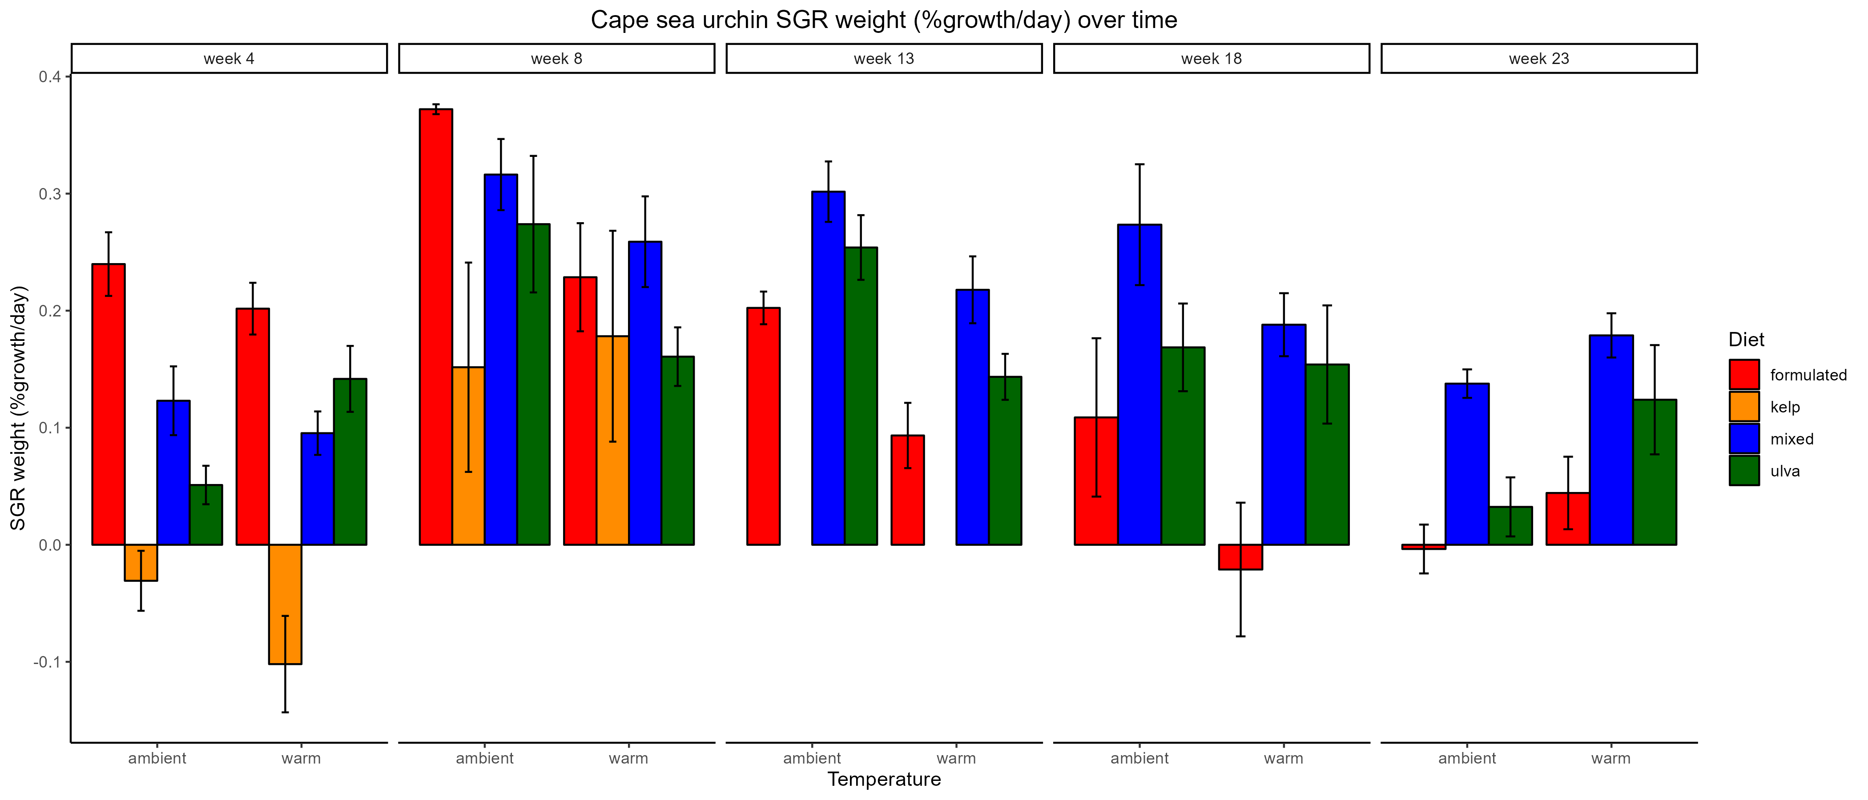
a
ab
ab
C
A
ab
C
ab
E
ab
ab
BC
DE
ABC
AB
b
AB
AB
C
CDE
AB
AB
BC
CDE
BC
BCD
A
BC
AB
AB
B
A
AB
A

Slide 3
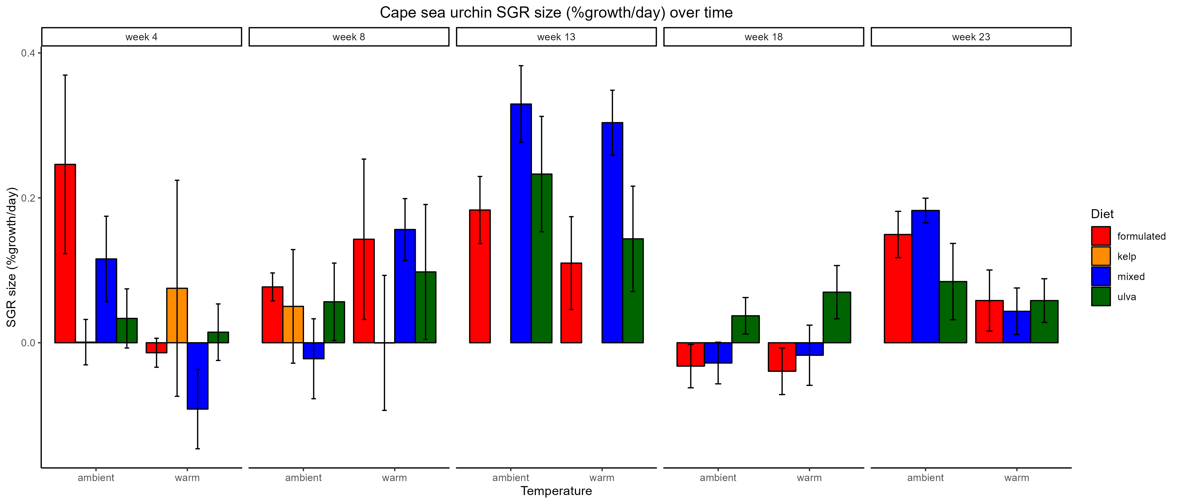

Slide 4
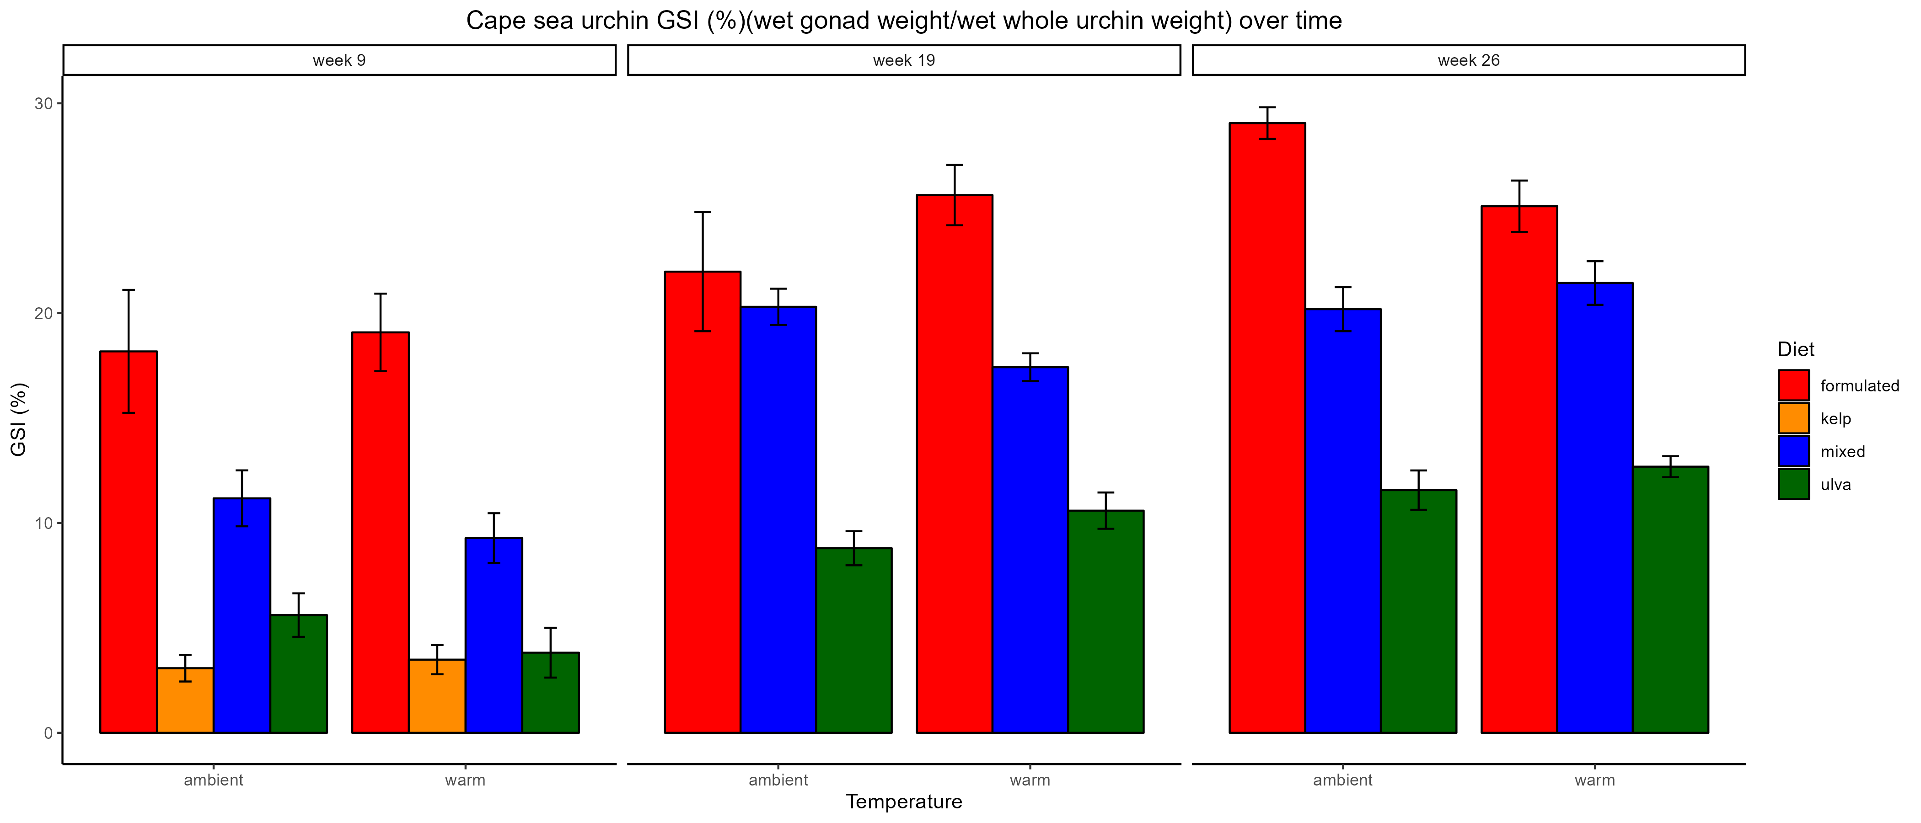
A
A
AB
A
B
a
a
A
B
AB
a
C
C
B
ac
B
abc
b
bc
b

Slide 5
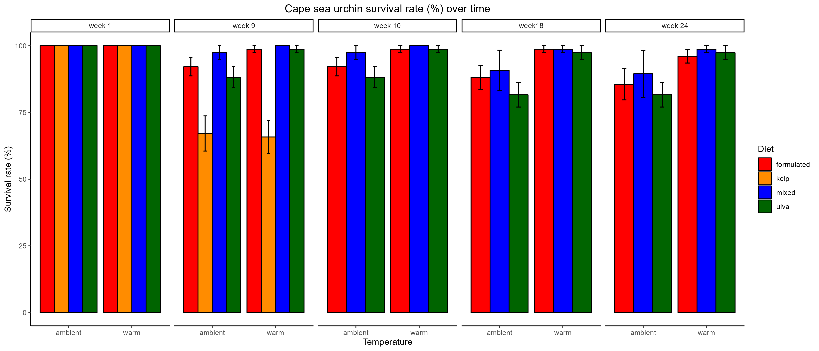
a
a
a
a
*
**
*
ab
ab
b
b

Slide 6
Doing diet & temp differences from now on
Diet as letters
Temp as stars

Slide 8
B
B
B
B
*
**
*
B
B
A
A

Slide 9
**
B
B
C
AB
B
C
A
AB
B
AB
B
A
AB
A
A
A
B
A
A
A
A
A
A
A
B
B

Slide 10
**
B
**
B
AB
A
AB
A
B
B
AB
A
AB
A

